Slide 1
United State Census Bureau’s
2017 Basic December CPS Analysis
Patrick Oseghale

Slide 2
Introduction
Our main goal in doing this analysis was to efficiently clean the data in order to determine whether participants would accept utilizing a telephone for an interview regardless of the accessibility of the device.
For the purpose of this Analytics, only the survey data from December 2017 will be used.
Steps involved:
Data extraction
Data preprocessing
Analysis
Presentation
03

Slide 3
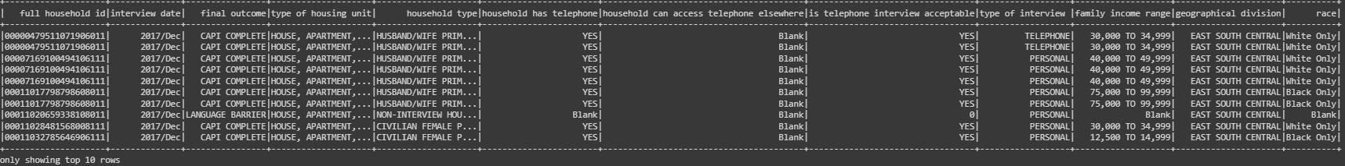
Sample of 10 Records only

Slide 4
Total Household Number
146,456
72,328
Responders
Distinct households

Slide 5
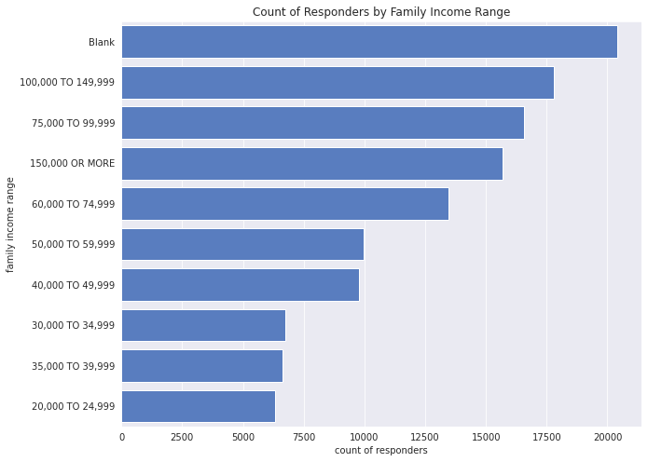
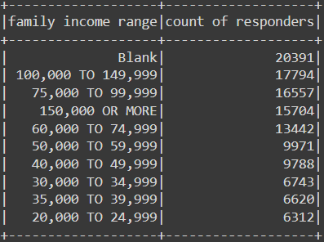
Count of Responders Per Family Income Range

Slide 6
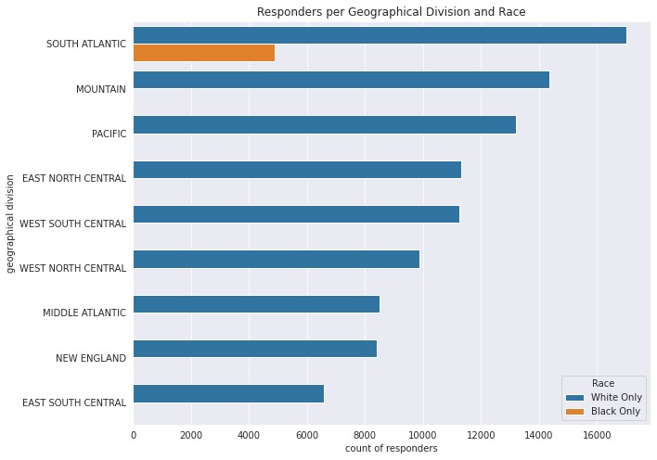
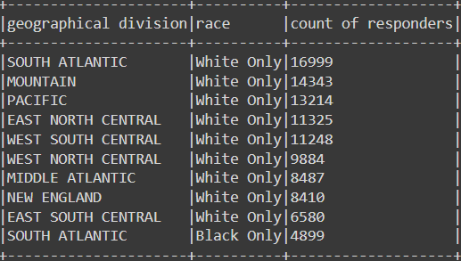
Count of Responders Per Geographical Location and Race

Slide 7
Household Number
633
0
Responders without Telephone in house but access it else where, and Telephone interview is accepted
Responders with telephone but Telephone Interview is not accepted

Slide 8
Thank You
Notes:
© Copyright PresentationGO.com – The free PowerPoint template library

